Slide 1
Computer Organization
2015 - 2016

Slide 2
Instructions
Language of The Computer
(MIPS)

Slide 3
Small Constant or Immediate Operands
A faster way is to use the arithmetic instruction version in which one operand is a constant of up to 16 bits
addi $s3, $s3, 4 # add immediate
# $s3 = $s3 + 4
Before performing the addition, addi extends the 16-bit immediate field of the instruction to a 32-bit word by copying the leftmost (sign) bit of the constant into the upper 16 bits of the word (sign extension)
e.g. 0000 0000 1100 0101 represents 389,it will be extended to 0000 0000 0000 0000 0000 0000 1100 0101

Slide 4
Small Constant or Immediate Operands
Since MIPS supports negative constants, there is no need for subtract immediate in MIPS
addi $s3, $s3, -4 # add immediate
# $s3 = $s3 - 4

Slide 5
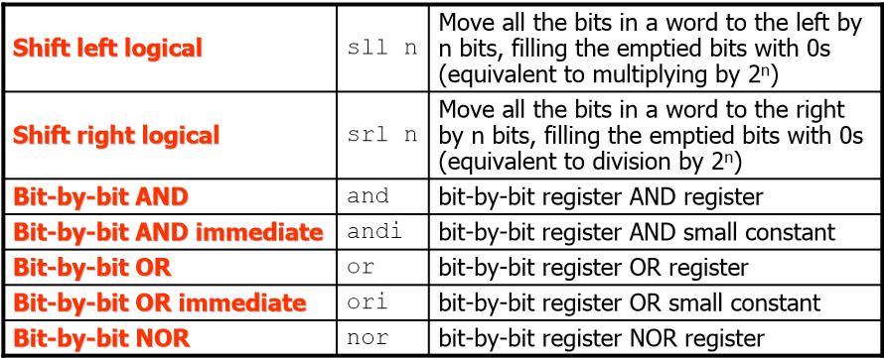
Logical (Bitwise) Instructions
NOT is implemented using a NOR with one operand being $zero for regularity

Slide 6
Exercise 1
Consider the following register contents:
$s0 = 0001 0000 1100 0101 1111 1100 0011 1010
$s1 = 0101 0110 1001 1111 0000 0011 1100 0101
What would the value in register $t0 be after executing each of the following instructions?
sll $t0, $s0, 4
and $t0, $s0, $s1
or $t0, $s0, $s1
nor $t0, $s0, $s1

Slide 7
Exercise 1 Sol.
$s0 = 0001 0000 1100 0101 1111 1100 0011 1010
$s1 = 0101 0110 1001 1111 0000 0011 1100 0101

Slide 8
Exercise 2
Write MIPS assembly instructions to
–Set bits 1, 5, and 12 of $s0 to 0
–Set bits 2, 3, 11 of $s0 to 1
–Invert all bits of $s0
Hint: you can use register $t1 for a mask

Slide 9
Exercise 2 Sol.
Set bits 1, 5, and 12 of $s0 to 0
$t1 = 1111 1111 111111111110 1111 1101 1101
and $s0, $s0, $t1
Set bits 2, 3, 11 of $s0 to 1
$t1 = 0000 00000000000000001000 0000 1100
or $s0, $s0, $t1
Invert all bits of $s0
nor $s0, $s0, $zero

Slide 10
Large Constants Handling
To handle larger constants, use the instruction load upper immediate load upper immediate (lui) to set the upper 16 bits of a constant in a register (filling the lower 16 bits with 0s), then use ori to specify the lower 16 bits

Slide 11
Exercise 3
What is the MIPS assembly code to load the following 32-bit constant into register $s0?
0000 0000 0011 1101 0000 1001 0000 0000

Slide 12
Exercise 3 Sol.
Lui $s0, 61 # 61 is 0000 0000 0011 1101
The value of register $s0 afterward is
Ori $s0,$s0,2304 # 2304 is 0000 1001 0000 0000
The value of register $s0 now is

Slide 13
Decision Making Instructions
Decision making instructions alter the control flow
Decisions can be done by:
–Choosing from two alternatives: if-else (may be combined with goto)
–Iterating a computation: loops(e.g., while, do-while, for, etc.)
–Selecting one of many alternatives: case/switch

Slide 14
Decision Making Instructions
MIPS conditional branch instructions:
beq $t0, $t1, Label # branch if equal
bne $t0, $t1, Label # branch if not equal
MIPS unconditional branch instructions:
j Label # Label is a word address
jr $t0 # jump register (to address in $t0)

Slide 15
Exercise 4
Assuming that the five integer variables f through j correspond to the five registers $s0 through $s4
What is the compiled MIPS assembly code for the following C code segment?
if(i == j)
gotoL1;
f = g + h;
L1:f = f -i;

Slide 16
Exercise 4 Sol.
C Code:
if(i == j)
gotoL1;
f = g + h;
L1:f = f -i;
MIPS Code:
beq $s3, $s4, L1
add $s0, $s1, $s2
L1:sub $s0, $s0, $s3

Slide 17
Exercise 5
Assuming that the five integer variables f through j correspond to the five registers $s0 through $s4
What is the compiled MIPS assembly code for the following C code segment?
if(i == j)
f = g + h;
else
f = g -h;

Slide 18
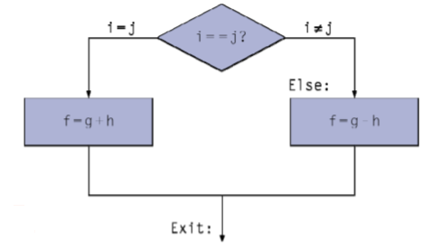
Exercise 5 Sol.
C Code: if(i == j)
f = g + h;
else
f = g -h;
MIPS Code:
bne $s3, $s4, Else
add $s0, $s1, $s2
j Exit
Else:sub $s0, $s1, $s2
Exit:

Slide 19
Register Compare
Slt $t0, $s3, $s4 # Set on less than
# Sets $t0 to 1 if $s3 < $s4
# else sets it to 0
Slti $t0, $s2, 10 # slti mmediate
# Sets $t0 to 1 if $s2 < 10
# else sets it to 0

Slide 20
Compare and Branch
MIPS architecture does not include a single compare and branch instruction because it is too complicated
Either it would stretch the clock cycle time or it would take extra clock cycles per instruction
Two faster instructions are more useful

Slide 21
Pseudoinstructions
Common variations of assembly instructions that are not part of the instruction set
Often appear in MIPS programs and are treated as regular ones
Their appearance in assembly language simplifies programming
The assembler produces a minimal sequence of actual MIPS instructions to accomplish their operations
The assembler uses the $at register to accomplish this, if needed

Slide 22
Exercise 6
Use MIPS instructions to implement the following pseudoinstructions:
clear $s3 # 0 →$s3
move $s3, $s4 # $s4 →$s3
not $s3, $s4 # not($s4) →$s3
blt $s3, $s4, Less # branch on less than

Slide 23
Exercise 6 Sol.
clear $s3 # 0 →$s3
add $s3, $zero, $zero # using $zero
move $s3, $s4 # $s4 →$s3
add $s3, $s4, $zero # Example 2 on using $zero
not $s3, $s4 # not($s4) →$s3
nor $s3, $s4, $zero # Example 3 on using $zero
blt $s3, $s4, Less # branch on less than
slt $at, $s3, $s4
bne $at, $zero, Less # Example 4 on using $zero

Slide 24
Exercise 7
Decompile the following MIPS assembly code to a C code segment
slti $at, $s5, 5
beq $at, $zero, Else
add $s6, $s5, $zero
j Exit
Else:add $s6, $zero, $zero
Exit:
Assume that the decompiler associates registers $s5 and $s6 with integer variables i and x

Slide 25
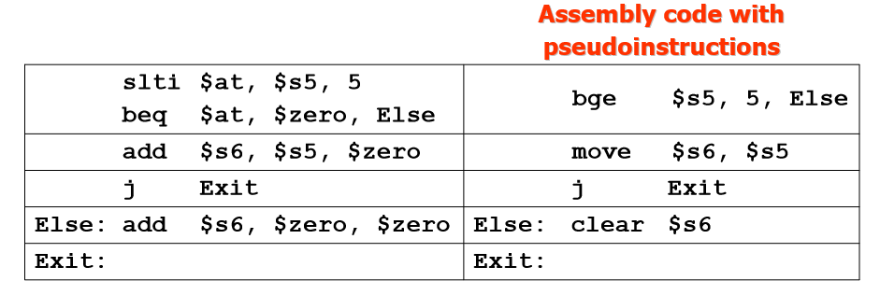
Exercise 7 Sol.
C Code: if(i < 5) x = i;
else x = 0;

Slide 26
Exercise 8
Assuming A is an integer array with base in $s4 and that the compiler associates the integer variables g, i, and n with the registers $s1, $s2, and $s3, respectively
What is the compiled MIPS assembly code for the following C code segment?
for(i = 0; i < n; i++)
g = g + A[i];

Slide 27
Exercise 8 Sol.
add $s2, $zero, $zero # i = 0
For: slt $t0, $s2, $s3 # test if i < n
beq $t0, $zero, Exit
sll $t1, $s2, 2 # $t1 = 4*i
add $t1, $t1, $s4 # $t1 has address of A[i]
lw $t2, 0 ($t1) # $t2 = A[i]
add $s1, $s1, $t2
addi $s2, $s2, 1 # increment i
j For
Exit:

